Slide 1
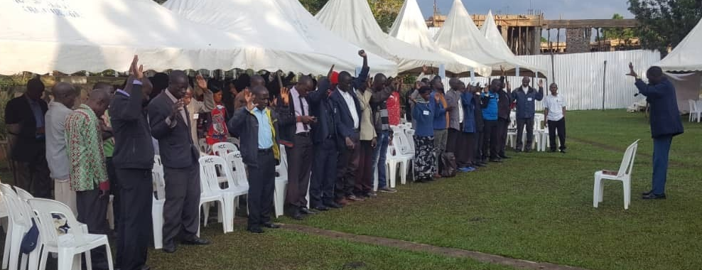
After these things I looked, and there was a huge multitude that no one could count—from every nation, tribe, people, and language—standing before the throne and in front of the Lamb. They were wearing white robes and holding palm branches in their hands (Revelation 7:9).
All Scripture taken from the English Unlocked Literal Bible (ULB), ©2017, 2022 Wycliffe Associates, Available at https://bibleineverylanguage.org/translations, licensed under the Creative Commons Attribution-ShareAlike 4.0 International License.
The English ULB is based on the unfoldingWord® Literal Text, CC BY-SA 4.0. The original work of the unfoldingWord® Literal Text is available at https://unfoldingword.bible/ult/.
Cultural and Social Considerations

Slide 2
But you, why do you judge your brother? And you, why do you despise your brother? For we will all stand before the judgment seat of God. … Therefore, let us no longer judge one another, but instead decide this, that no one will place a stumbling block or a snare for his brother (Rom. 14:10, 13).
"Everything is lawful," but not everything is profitable. "Everything is lawful," but not everything builds people up. No one should seek his own good. Instead, each one should seek the good of his neighbor (1 Cor. 10:23-24).

Slide 3
?

Slide 4
1 Chronicles 29:9
The people rejoiced because of these freewill offerings, because they had contributed wholeheartedly to Yahweh. King David also rejoiced greatly.

Slide 5
Matthew 23:12
Whoever exalts himself will be humbled, and whoever humbles himself will be exalted.

Slide 6
Exodus 35:29
The people of Israel brought a freewill offering to Yahweh; every man and woman whose heart was willing brought materials for all the work that Yahweh had commanded through Moses to be made.

Slide 7
Ephesians 2:10
For we are God's workmanship, created in Christ Jesus to do good deeds that God planned long ago for us, so that we would walk in them.

Slide 8
1 Corinthians 16:17
I rejoice at the coming of Stephanas, Fortunatus, and Achaicus. They have made up for your absence.

Slide 9
Proverbs 1:5
Let wise people listen and increase their learning,
and let discerning people get wise counsel,

Slide 10
Matthew 18:4
Therefore, whoever humbles himself like this little child is the greatest in the kingdom of heaven.

Slide 11
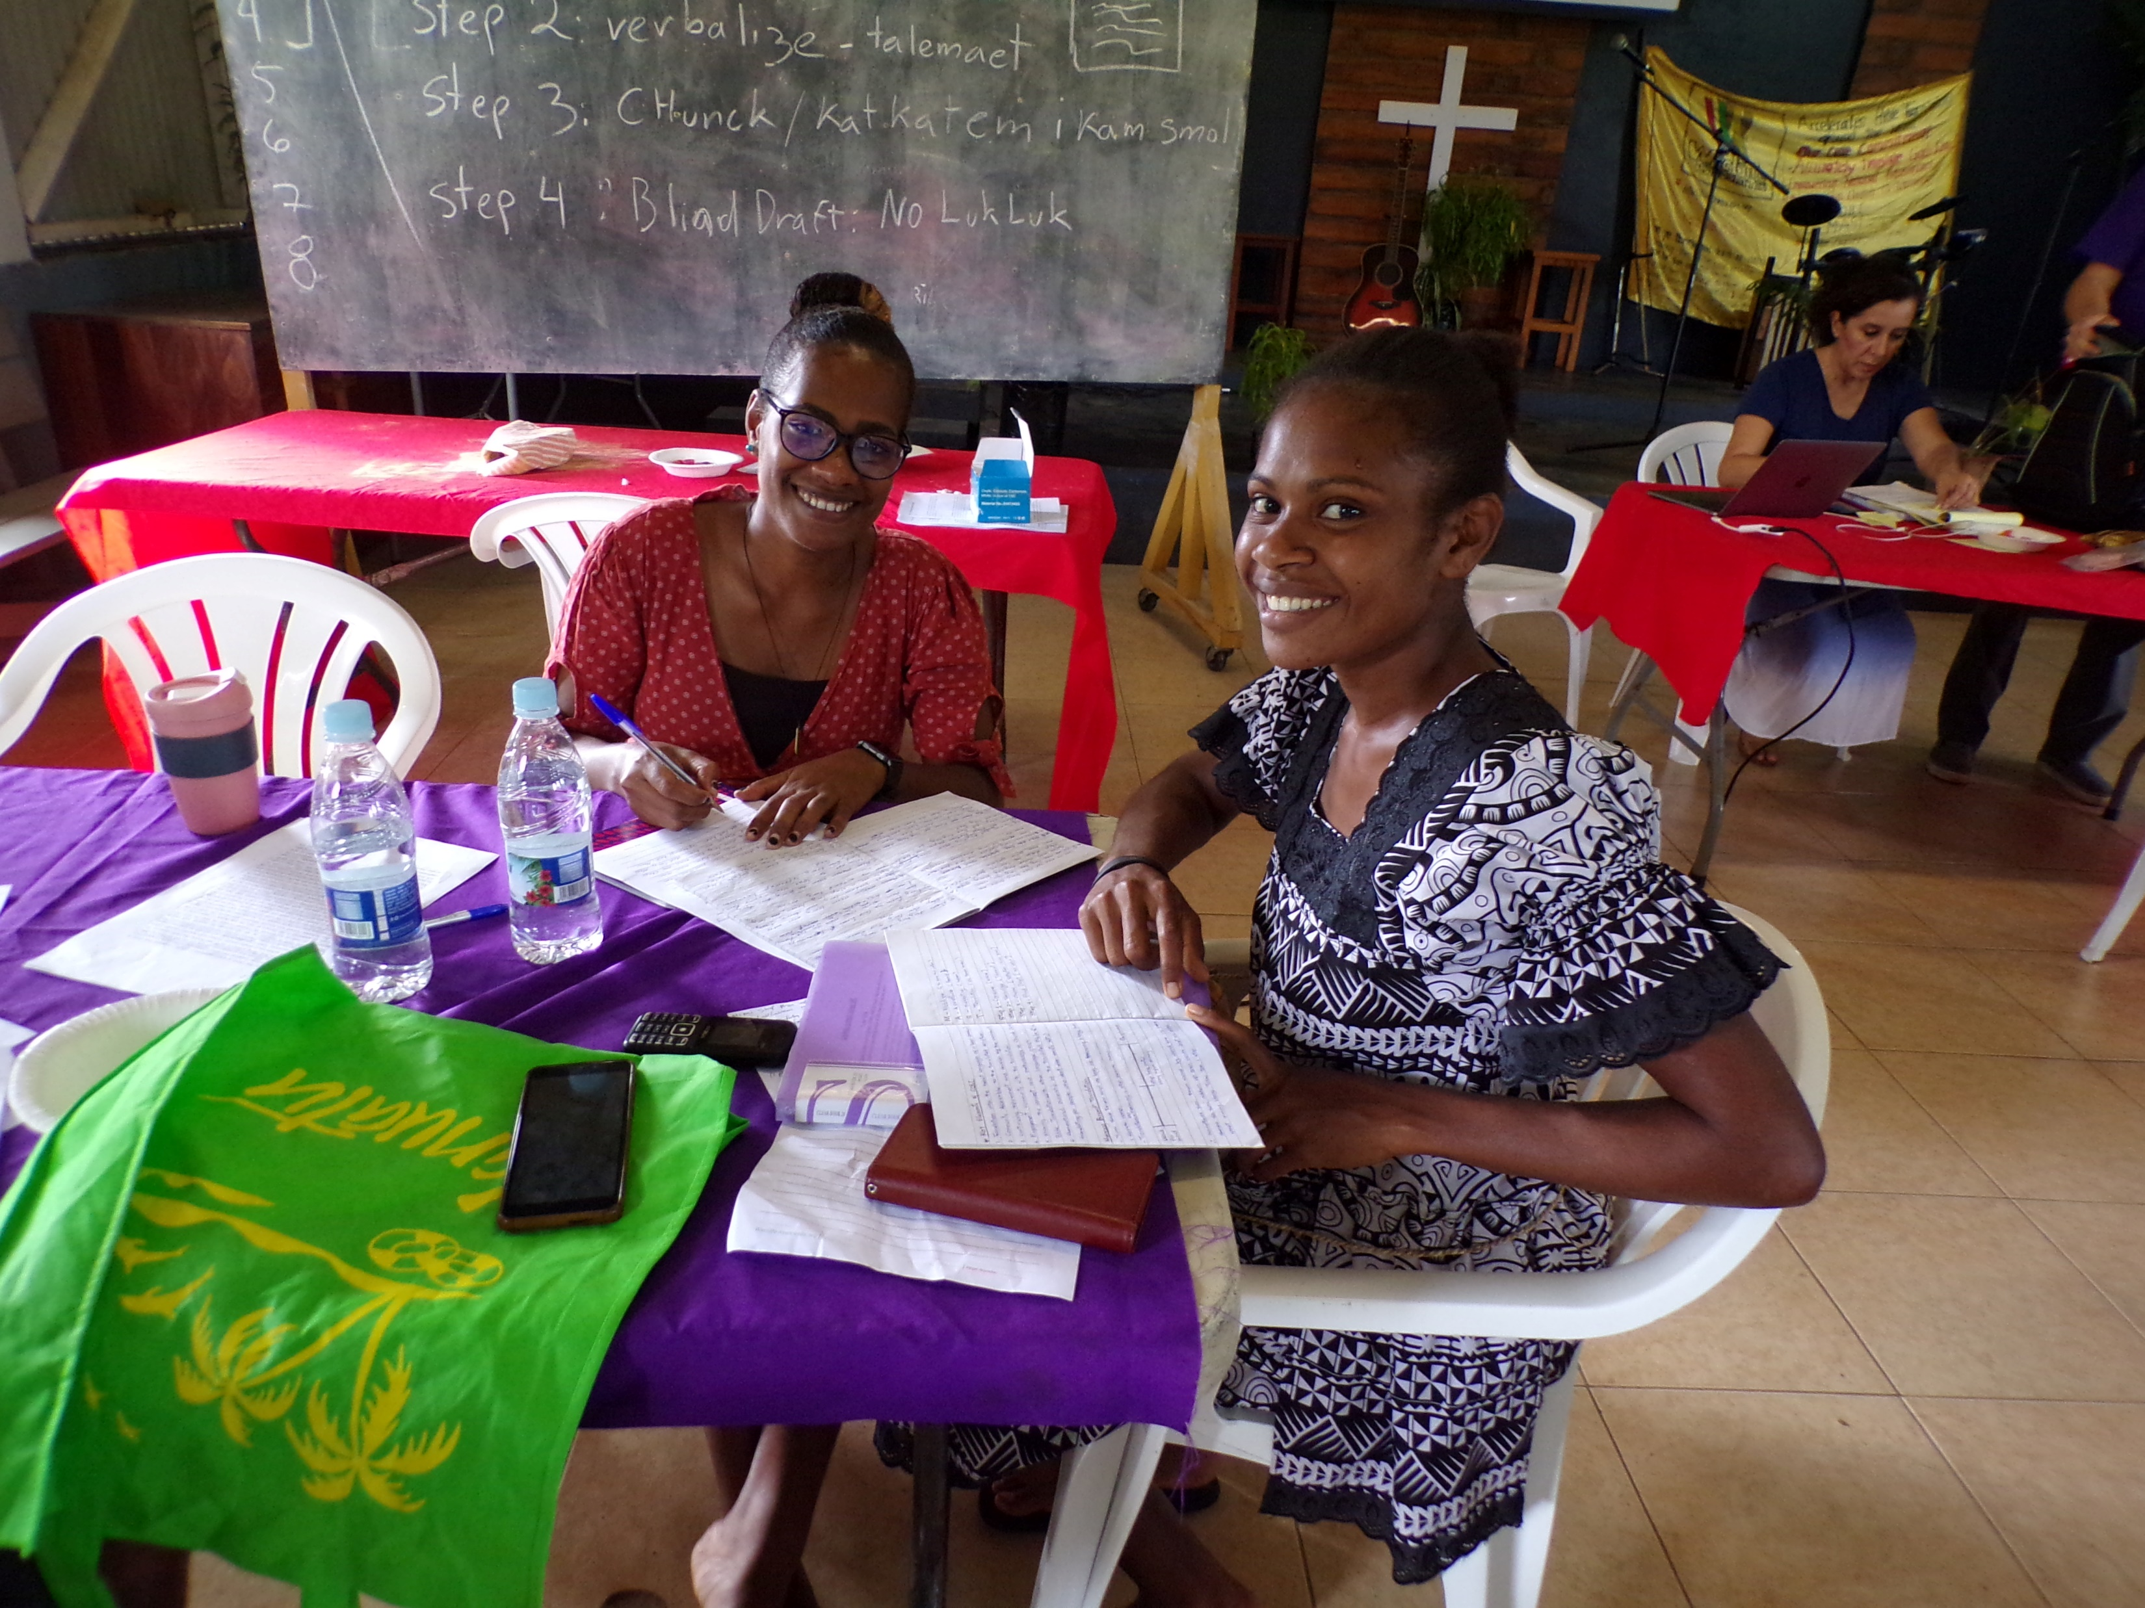
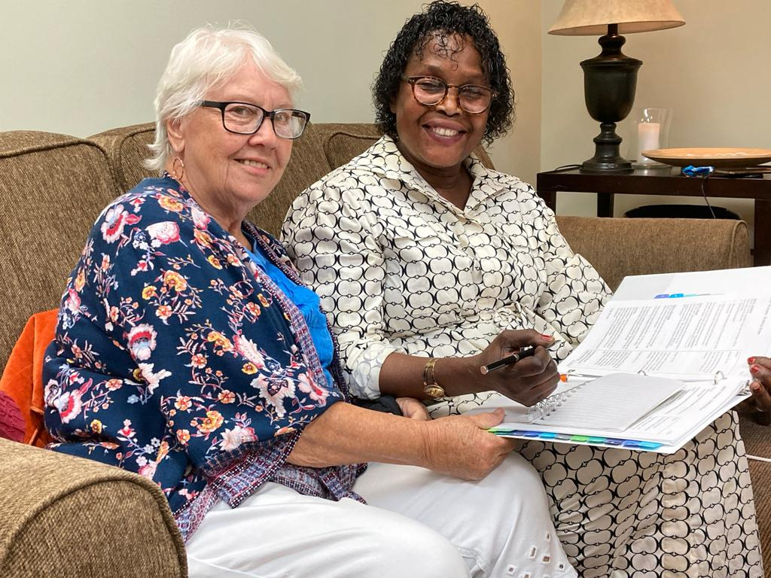
WHO
we have in common
is more important
than all our differences.

